Slide 1
Section #6
November 13th 2009
Regression

Slide 2
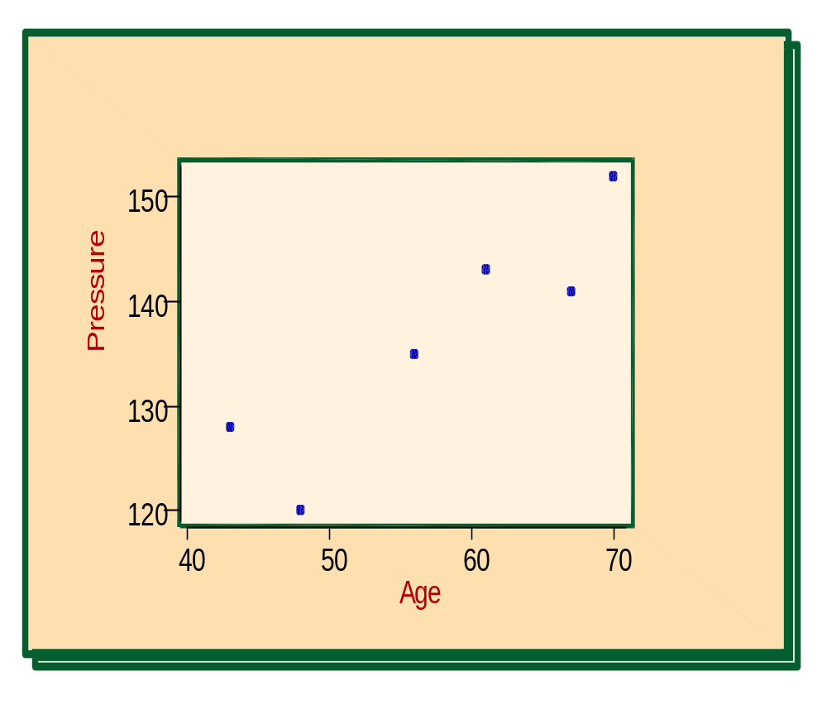
First, Review
Scatter Plots
A scatter plot is a graph of the ordered pairs (x, y) of numbers consisting of the independent variable, x, and the dependent variable, y.
Positive Relationship

Slide 3
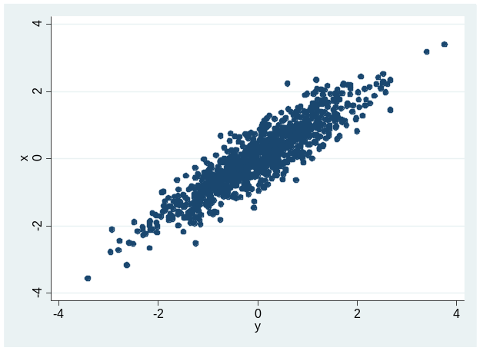
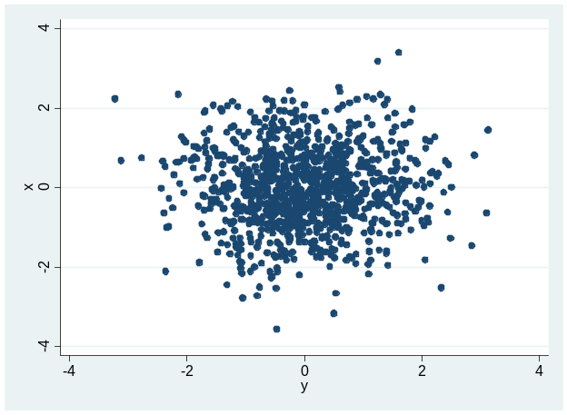
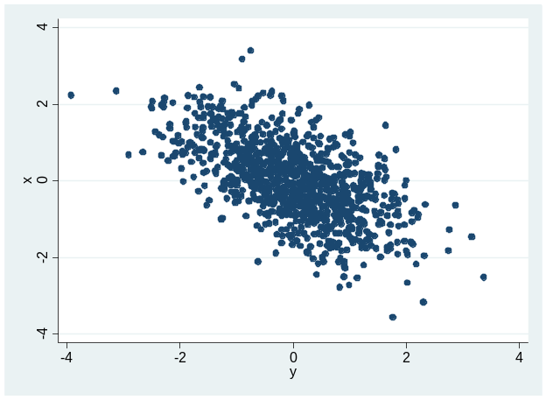
Review….Correlation
The correlation coefficient r quantifies this; r ranges from -1 (perfect negative relationship) to 0 (no linear relationship) to 1 (perfect positive relationship)
r = .9
Strong positive relationship
r = 0
No linear relationship
r = -.6
Moderate neg. relationship

Slide 4
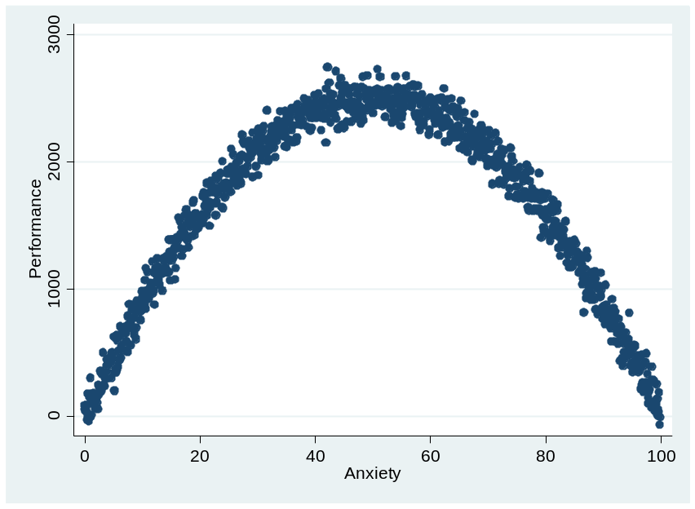
Correlation cont’d
Note that the correlation coefficient r only measures linear relationships (how close the data fit a straight line)
It is possible to have a strong nonlinear relationship between two variables (e.g., anxiety and performance) while still having r = 0
Moral of the story: Never rely only on correlations to tell you the whole story

Slide 5
Computing correlation
z-score product formula
raw-score formula
Notes:
Looking for relationship between z-scores of x and y variables for each case – want an average of these differences.
Again, if you just subtracted zx-zy, you would get zero b/c mean of z is zero.
Like we did with sd, you have to square these differences.
Look up proof in book to get from this intuitive z score difference formula to the z score product formula kenji shared in class.
Z=x-xbar/sd

Slide 6
Correlation & Covariance
Covariance is a measure of the extent to which two random variables move together
  Written as cov(X,Y) or σ_{XY}
  This is the numerator in the “raw score” formula
Correlation is the covariance of X & Y divided by their standard deviations
  Prefer it to covariance b/c covariance units are awkward, the same reason we prefer standard deviation to variance
  Written as corr(X,Y) or ρ

Slide 7
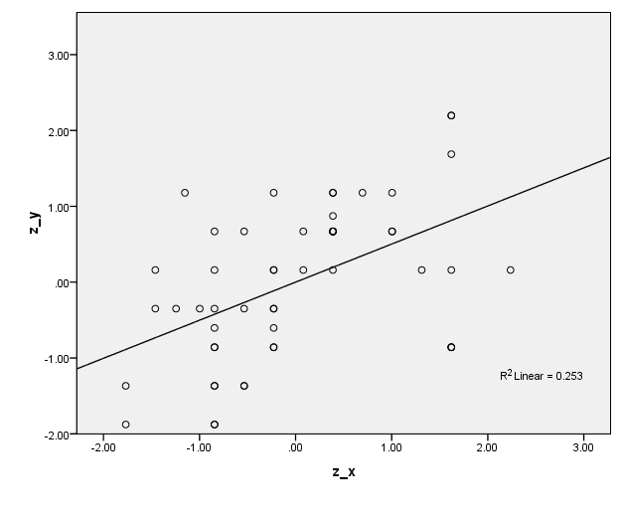
Regression

Slide 8
A refresher: Equations for lines
For constants (numbers) m and b, the equation
y = mx + b represents a line
  In other words, a point (x, y) is on the line if and only if it satisfies the equation:
  y = mx + b
  b represents the y-intercept: the y coordinate of the line when x = 0
  m represents the slope: the amount by which y increases if x is increased by 1
How would you interpret the equation at right?
y = 1.4 + .6x
.6
1
1.4

Slide 9

Equations for Lines:
7th grade & grad school lingo
y = mx + b
Y = B₁ X + B₀
“Parameters” or
“Coefficients”
“Variables”

Slide 10

X & Y
We are accustomed to looking at just one variable, and calling it “X”.
Now that we look at two variables, we generally call the IV “X” and the DV “Y”.
Therefore, with regression, we will often be looking at Y’ or Y hat ( ), since that is the variable we are trying to predict.
The population parameter for Y is often expressed as or E(Y).

Slide 11

How do we estimate the line?
Our model says that Y_{i} is found by multiplying X_{i} by β₁ and adding β_{0.}
We estimate β₁ using the estimator from a sample.
It turns out that the line that minimizes the sum of squared residuals can be computed analytically from the following expression:

Slide 12




Slide 13
Explained and unexplained variance
Total Variance:
Explained Variance:
Unexplained Variance:
SS_{total} = SS_{explained} + SS_{unexplained}

Slide 14
Error
For individual score:
Average across all scores:
(Variance of Errors)
In original units:
(Standard Error of Estimate)

Slide 15
Standard Error of Estimate
Biased
Unbiased

Slide 16
Let’s try a problem…
Student | Exam Score | Undergrad GPA
1 | 92 | 4.0
2 | 87 | 3.2
3 | 70 | 2.9
4 | 80 | 3.5
5 | 95 | 3.7

Slide 17
Last Time…Correlation
Compute mean and unbiased standard deviation of each variable.
Convert both variables to z-scores
Compute correlation using the z-score product formula Kenji taught us in class.
Try to compute the correlation again, this time using the raw-score formula for unbiased sd.
Student | Exam Score Y | z-exam | Undergrad GPA X | z-gpa
1 | 92 | 0.72 | 4 | 1.26
2 | 87 | 0.22 | 3.2 | -0.61
3 | 70 | -1.48 | 2.9 | -1.31
4 | 80 | -0.48 | 3.5 | 0.09
5 | 95 | 1.02 | 3.7 | 0.56
mean | 84.8 |  | 3.46
s | 10.034939 |  | 0.427785
r = 0.81
Notes:
Sd = square root [sum (x-xbar)squared/N-1]

Slide 18
This time…Regression
Use the data and results to compute a linear regression equation for predicting exam score from undergrad GPA
Use the linear regression equation to compute predicted exam score (y hat) for each student.
Compute the residual, or error, for each student. Square each of these values.
Compute the standard error of the estimate for predicting Y (exam score) from X (GPA).

Slide 19
1. compute a linear regression equation
Sy =
Sx =
r xy =
Y bar =
X bar =

Slide 20
1. compute a linear regression equation
Sy = 10.03 B1hat =
Sx = 0.43 B0 hat =
r xy = 0.81
Y bar = 84.8 Y = _____ X + _____
X bar = 3.46

Slide 21
1. compute a linear regression equation
Sy = 10.03 B1hat = 18.89
Sx = 0.43 B0 hat = 19.44
r xy = 0.81
Y bar = 84.8 Y = 18.89 X + 19.44
X bar = 3.46

Slide 22
Avoiding Causal Language
When describing
You should say:
  “On average, a 1-unit difference in the X variable is associated with a d unit difference in the Y variable.”
  Or “On average, a 1-point difference in the X variable corresponds to a d point difference in the Y variable.”
  Give context to your description
You should not use causal language
  “A one unit change in X increases Y by d units”
  “A change of one unit in X results in …”

Slide 23
2. Use the linear regression equation to compute predicted exam score (y hat) for each student.
Y = 18.89 X + 19.44
Student | GPA (X) | Predicted Exam Scores (Y hat, Y’)
1 | 4
2 | 3.2
3 | 2.9
4 | 3.5
5 | 3.7

Slide 24
2. Predict Y hat (Y’)
Student | Undergrad GPA (X) | Exam Score (Y) | Predicted Exam Scores (Y')
1 | 4 | 92 | 95.00
2 | 3.2 | 87 | 79.89
3 | 2.9 | 70 | 74.22
4 | 3.5 | 80 | 85.56
5 | 3.7 | 95 | 89.33

Slide 25
3. Compute the residual, or error, for each student.
Square each of these values.
Student | Undergrad GPA (X) | Exam Score (Y) | Predicted Exam Scores (Y') | Error (Y-Y') | Squared Error
1 | 4 | 92 | 95.00
2 | 3.2 | 87 | 79.89
3 | 2.9 | 70 | 74.22
4 | 3.5 | 80 | 85.56
5 | 3.7 | 95 | 89.33

Slide 26
3. Residuals
Student | Undergrad GPA (X) | Exam Score (Y) | Predicted Exam Scores (Y') | Error (Y-Y') | Squared Error
1 | 4 | 92 | 95.00 | -3.00 | 9.00
2 | 3.2 | 87 | 79.89 | 7.11 | 50.58
3 | 2.9 | 70 | 74.22 | -4.22 | 17.82
4 | 3.5 | 80 | 85.56 | -5.56 | 30.86
5 | 3.7 | 95 | 89.33 | 5.67 | 32.11

Slide 27
4. Standard Error
Sy =
N =
r =
r squared =

Slide 28
4. Standard Error
Sy = 10.03 Syhat =
N = 5
r = 0.81
r squared = 0.66
Notes:
10.03*sqrt(1.33*0.34)

Slide 29
4. Standard Error
Sy = 10.03 Syhat = 6.75
N = 5
r = 0.81
r squared = 0.66
Notes:
10.03*sqrt(1.33*0.34)

Slide 30
Other things you may find useful

Slide 31
testing significance of r

Slide 32
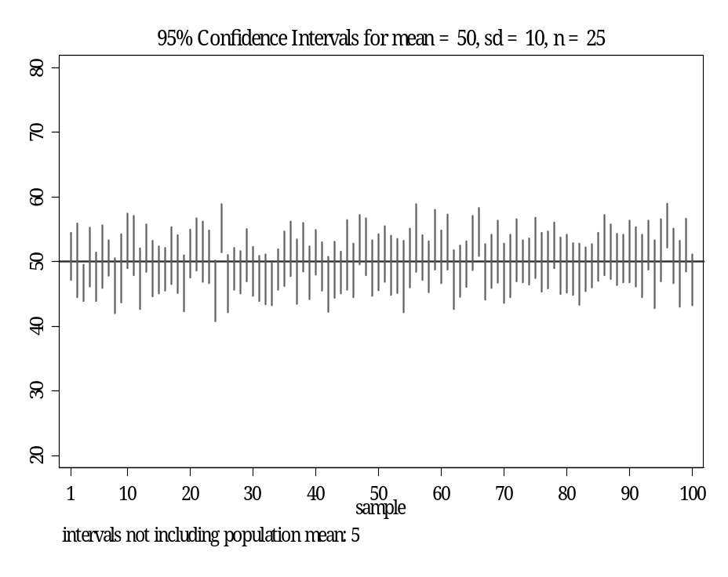
95% Confidence Interval
Assume the population mean μ=50 and standard deviation=10
Draw 100 random samples, each with n=25
Calculate the sample mean , standard error, and 95%CI for each of the 100 random samples
The true population mean of 50 should be contained within 95 of those 100 95%CIs
Therefore, when we base the conclusions of hypothesis test on the 95%CI, we will likely reject a true null hypothesis 5% of the time.
  Given the same first two bullets above, how would we reject fewer true null hypotheses (H₀: μ=50)?
Example of a “Type I error” (i.e., falsely rejecting a true null hypothesis)—e.g., the 2nd circled obs above (i=25)
  =56, se( )=2
  note: critical t_{25,1,2-sided}=2.06
  95%CI=[ -2.06*se, -2.06*se]=
  (56-2.06*2,56+2.06*2)=(52,60)
  Since H₀: μ=50, and 50 is not between 52 and 60, we would reject the true null hypothesis

